Slide 1
PHP Session by Ali Khorsandfard date: 21.05.2024 v1.0.0

Slide 2
Agenda
Introduction to PHP Sessions
How a PHP Session Works
Creating a Session on the Server
Session ID and Cookies
Session Storage on Apache Server
Managing Sessions in PHP
Security Considerations

Slide 3
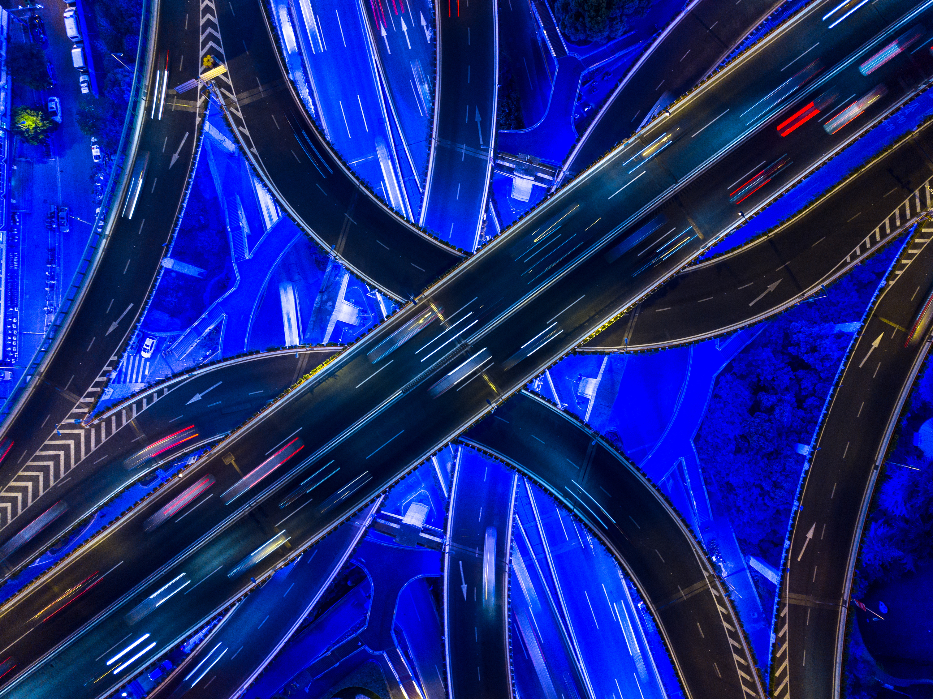
Introduction to PHP Sessions

Slide 4
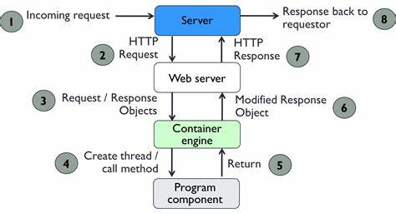
What is session (1/7)
We know at first step user make request on our server and server redirect request to Webserver
If page is simple html , there will be no session need.
If page is php , maybe it need session
Conclusion: session will be created only if needed!
Conclusion: session will be created anytime Developer needed and we as developer will create it
Creating session is very easy!

Slide 5
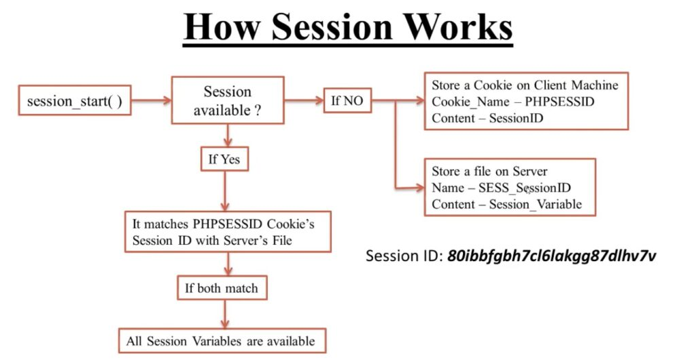
What is session (1/7)
Definition: A PHP session is a way to store information (variables) to be used across multiple pages.
Purpose:
Maintain user state and data across different web pages.
Essential for implementing login systems, shopping carts, and user activity tracking.
Session Data Storage: Data is stored on the server and associated with a unique session ID.

Slide 6
How a PHP Session Works

Slide 7
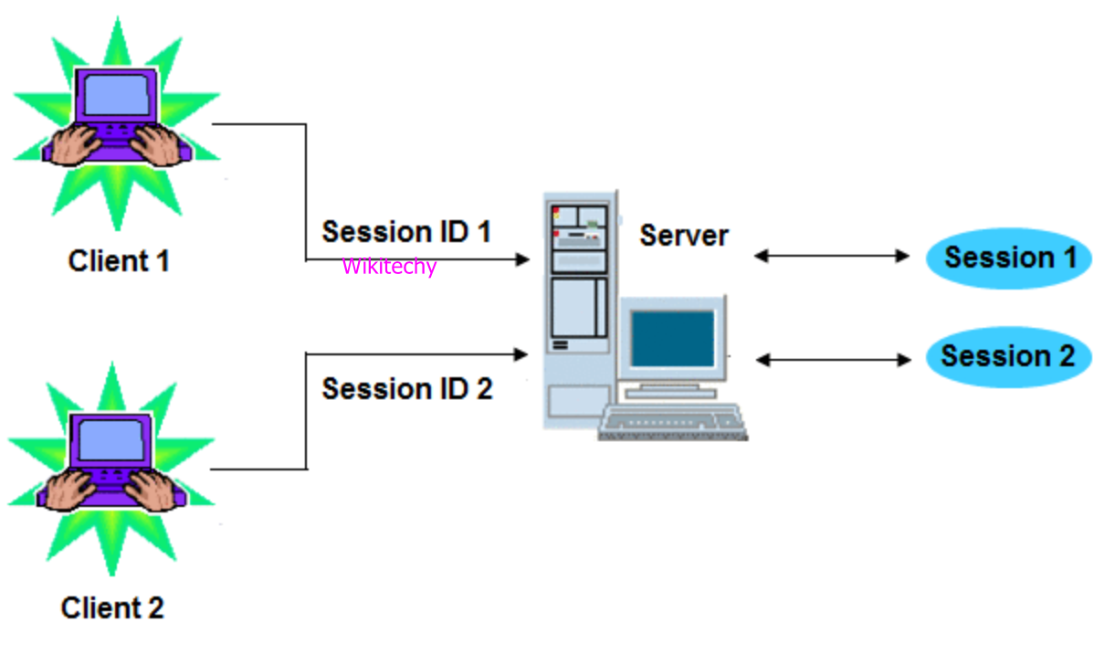
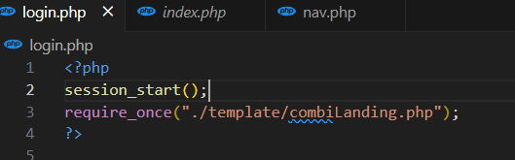
How Does a PHP Session Work? (2/7)
Process Overview:
Session Start: PHP starts a session using session_start().
Session ID: A unique session ID is generated.
Session Storage: Session data is stored on the server.
Session ID Cookie: The session ID is sent to the user's browser as a cookie.
Data Retrieval: On subsequent requests, the session ID is sent back to the server, allowing access to the stored session data.

Slide 8
Creating a Session on the Server

Slide 9
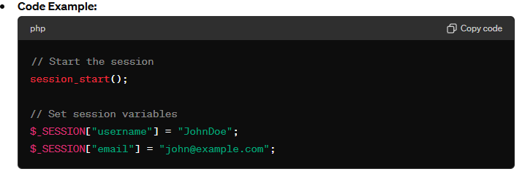
Creating a Session on the Server (3/7)
Explanation:
session_start(): Initializes a new session or resumes an existing one.
$_SESSION Superglobal: Used to store and access session variables.

Slide 10
Session ID and Cookies

Slide 11
Session ID and Cookies (4/7)
Session ID:
A unique identifier assigned to each session.
Typically stored in a cookie (PHPSESSID).
Cookie Handling:
Sent automatically with each request/response.
If cookies are disabled, the session ID can be passed via URL (less secure).

Slide 12
Session Storage on Apache Server

Slide 13
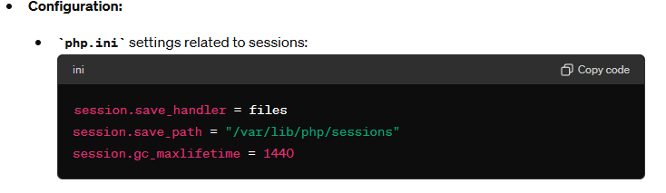
Session Storage on Apache Server (5/7)
Default Storage Location:
Sessions are typically stored in files in a directory specified by php.ini.
Example Path: /var/lib/php/sessions

Slide 14
Managing Sessions in PHP

Slide 15
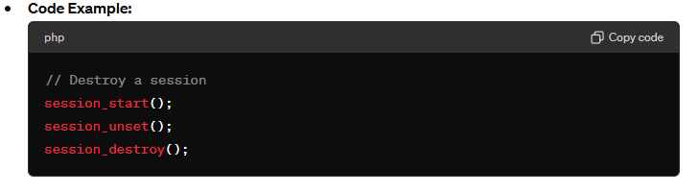
Managing Sessions in PHP (6/7)
Common Functions:
session_start(): Start or resume a session.
$_SESSION: Superglobal array for session variables.
session_destroy(): Destroy the session and its data.
session_unset(): Unset all session variables.

Slide 16
Security Considerations

Slide 17
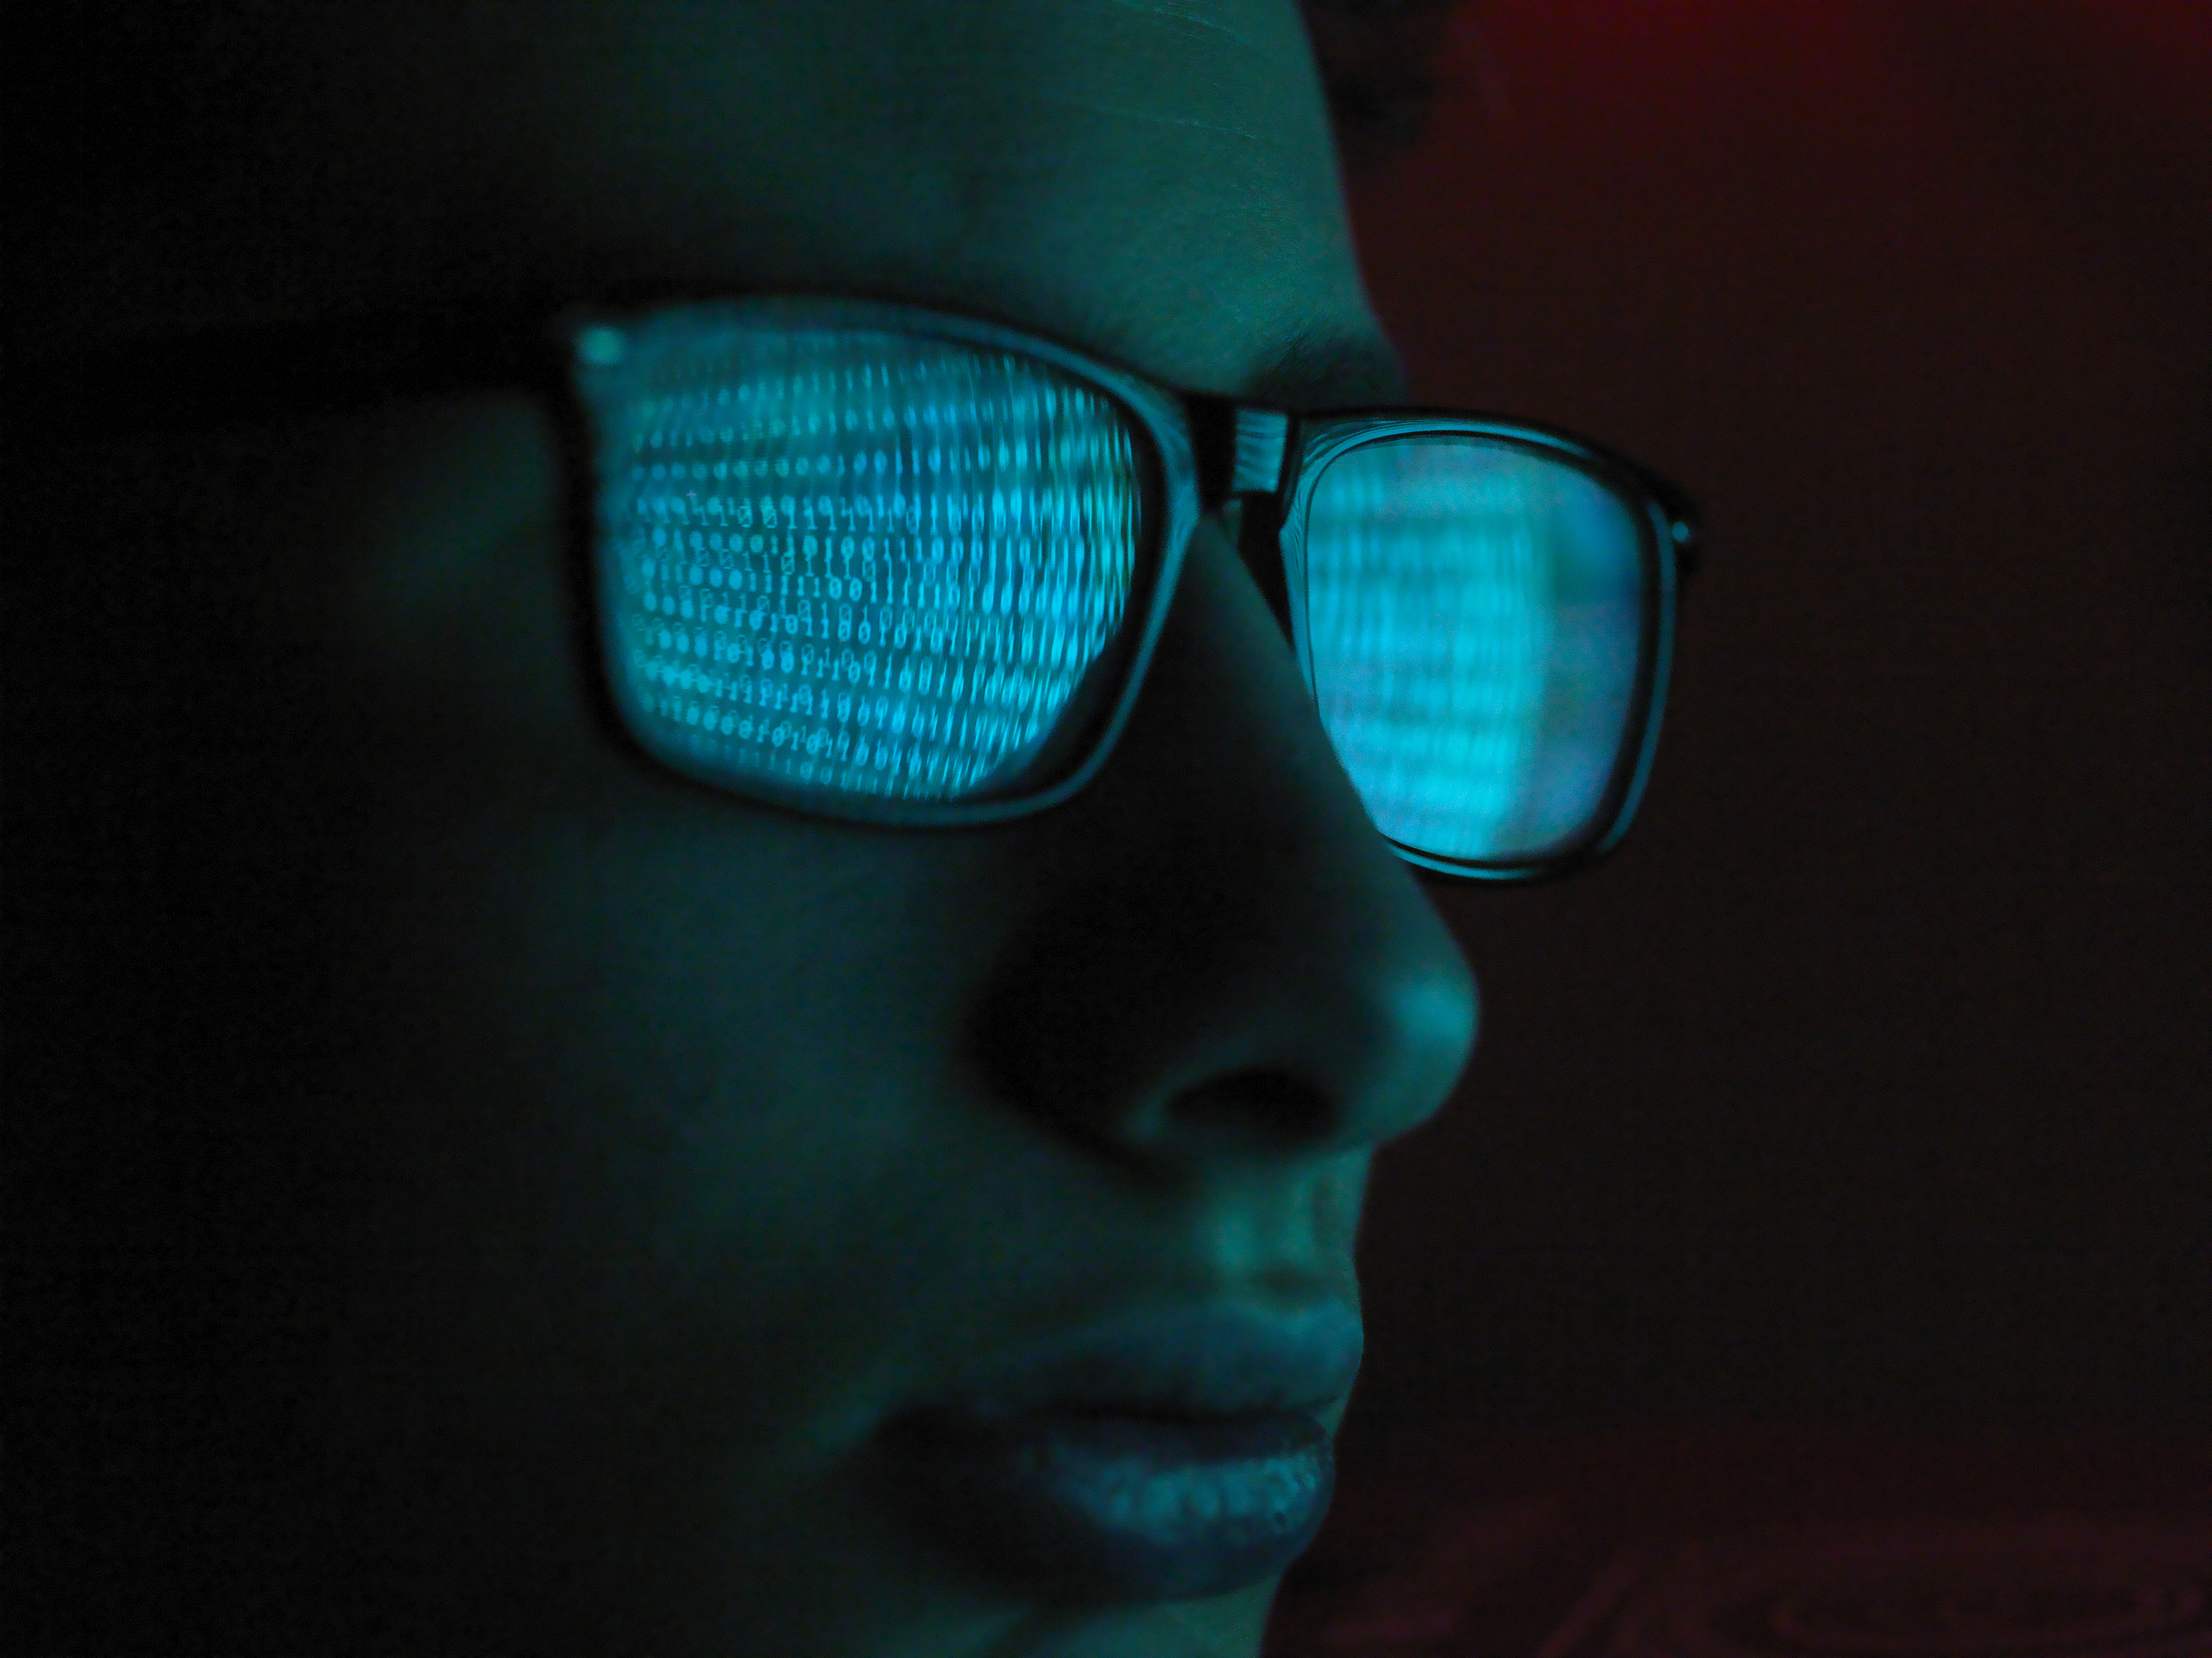
Security Considerations (7/7)
Session Hijacking: Protect session IDs from being stolen.
Use session_regenerate_id() to regenerate session IDs periodically.
Session Fixation: Ensure new session IDs upon login.
HTTPS: Use HTTPS to encrypt session data in transit.
Session Timeout: Implement session expiration for inactivity.

Slide 18
THANK YOU
Ali Khorsandfard
Ali.khorsandfard@gmail.com​

